Slide 1
About Me
Ritesh Singh
Sun Certified java Professional
Oracle Certified Database Administrator
Certified Ethical Hacker
Certified EC-Council Instructor (CEI)

Slide 2
Course Overview
What is a Sequence Diagram?
Purpose of Sequence Diagram
Sequence diagram example
Sequence Diagram Notation
Benefits of a Sequence Diagram

Slide 3
What is a Sequence Diagram?
SEQUENCE DIAGRAM simply depicts interaction between objects in a sequential order. The purpose of a sequence diagram in UML is to visualize the sequence of a message flow in the system.
The sequence diagram shows the interaction between two lifelines as a time-ordered sequence of events.
A sequence diagram shows an implementation of a scenario in the system.

Slide 4
Purpose of Sequence Diagram
Model high-level interaction between active objects in a system
Model the interaction between object instances within a collaboration that realizes a use case
Model the interaction between objects within a collaboration that realizes an operation
Either model generic interactions (showing all possible paths through the interaction) or specific instances of a interaction (showing just one path through the interaction)

Slide 5
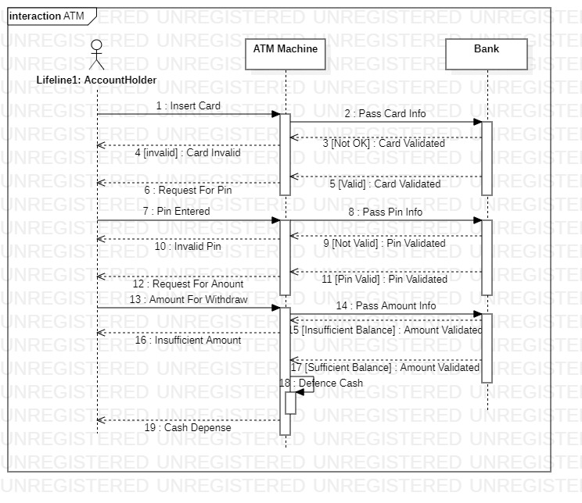
Sequence diagram example

Slide 6
Sequence Diagram Notation
Actor
a type of role played by an entity that interacts with the subject (e.g., by exchanging signals and data)
external to the subject (i.e., in the sense that an instance of an actor is not a part of the instance of its corresponding subject).
represent roles played by human users, external hardware, or other subjects.

Slide 7
Sequence Diagram Notation continue …
Note that:
An actor does not necessarily represent a specific physical entity but merely a particular role of some entity
A person may play the role of several different actors and, conversely, a given actor may be played by multiple different person.

Slide 8

Sequence Diagram Notation continue …
Lifeline
A lifeline represents an individual participant in the Interaction.

Slide 9

Sequence Diagram Notation continue …
Activations
A thin rectangle on a lifeline) represents the period during which an element is performing an operation.
The top and the bottom of the of the rectangle are aligned with the initiation and the completion time respectively

Slide 10

Sequence Diagram Notation continue …
Call Message
A message defines a particular communication between Lifelines of an Interaction.
Call message is a kind of message that represents an invocation of operation of target lifeline.

Slide 11

Sequence Diagram Notation continue …
Return Message
A message defines a particular communication between Lifelines of an Interaction.
Return message is a kind of message that represents the pass of information back to the caller of a corresponded former message.

Slide 12

Sequence Diagram Notation continue …
Self Message
A message defines a particular communication between Lifelines of an Interaction.
Self message is a kind of message that represents the invocation of message of the same lifeline.

Slide 13

Sequence Diagram Notation continue …
Recursive Message
A message defines a particular communication between Lifelines of an Interaction.
Recursive message is a kind of message that represents the invocation of message of the same lifeline. It's target points to an activation on top of the activation where the message was invoked from.

Slide 14
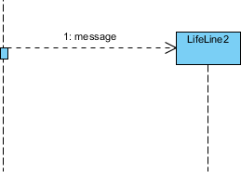
Sequence Diagram Notation continue …
Create Message
A message defines a particular communication between Lifelines of an Interaction.
Create message is a kind of message that represents the instantiation of (target) lifeline.

Slide 15
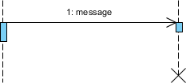
Sequence Diagram Notation continue …
Destroy Message
A message defines a particular communication between Lifelines of an Interaction.
Destroy message is a kind of message that represents the request of destroying the lifecycle of target lifeline.

Slide 16
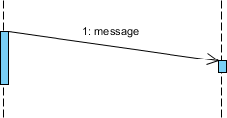
Sequence Diagram Notation continue …
Duration Message
A message defines a particular communication between Lifelines of an Interaction.
Duration message shows the distance between two time instants for a message invocation.

Slide 17

Sequence Diagram Notation continue …
Note
A note (comment) gives the ability to attach various remarks to elements. A comment carries no semantic force, but may contain information that is useful to a modeler.

Slide 18
Benefits of a Sequence Diagram
Sequence diagrams are used to explore any real application or a system.
Sequence diagrams are used to represent message flow from one object to another object.
Sequence diagrams are easier to maintain.
Sequence diagrams are easier to generate.
Sequence diagrams can be easily updated according to the changes within a system.
Sequence diagram allows reverse as well as forward engineering.

Slide 19
Thank You

